Slide 1


When two’s a crowd! Using experimental design to explore soilborne disease interactions Bethany Rognoni, Clayton Forknall Australasian Applied Statistics Conference 2022

Slide 2
Why do we love experimental design?
We can determine cause and effect!
We can block over factors we think are suspicious!
We can control for known factors that may influence the results!
Randomisation makes our results less likely to be biased!
Replication makes our results more trustworthy!

Slide 3
Why do we love experimental design?
We love to solve tricky puzzles …
that have an impact on the world!
The rules of the puzzle are often determined by real-world limitations!

Slide 4

Solving this experimental design puzzle!
Learn the rules
What kind of puzzle are we dealing with?
Prep our strategy
What statistical techniques can we use to help solve the puzzle?
Real-world puzzling
How does it play out in practice?

Slide 5
Solving this experimental design puzzle!
Learn the rules
What kind of puzzle are we dealing with?
Prep our strategy
What statistical techniques can we use to help solve the puzzle?
Real-world puzzling
How does it play out in practice?

Slide 6
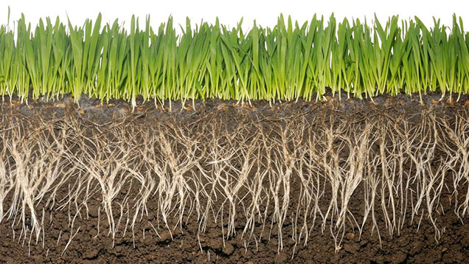
Learn the rules: What kind of puzzle are we dealing with?
SOILBORNE DISEASES
Crown rot
Fusarium pseudograminearum
Rhizo
Rhizoctonia solani
Root-lesion nematodes
Pratylenchus spp.
Common root rot
Bipolaris sorokiniana
Take-all
Gaeumannomyces tritici

Slide 7
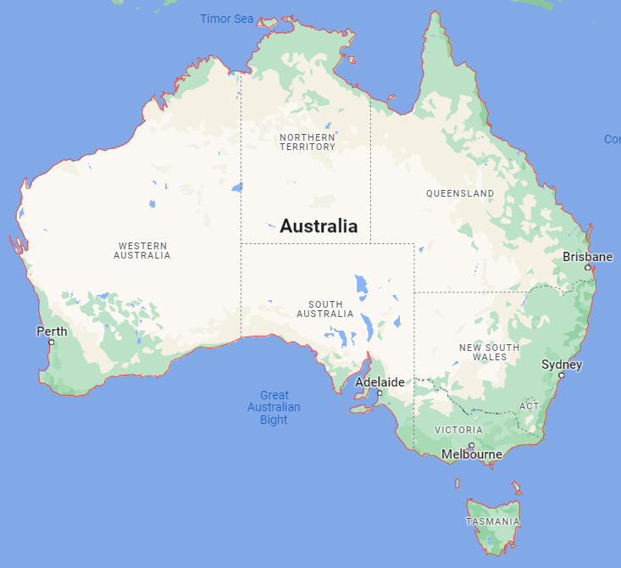









Learn the rules: What kind of puzzle are we dealing with?
Our motivating project
GRDC project: Soilborne disease interactions in Australian farming systems
© Google 2022

Slide 8
Learn the rules: What kind of puzzle are we dealing with?
SOILBORNE DISEASES
Crown rot
Fusarium pseudograminearum
Rhizo
Rhizoctonia solani
Root-lesion nematodes
Pratylenchus spp.
Common root rot
Bipolaris sorokiniana
Take-all
Gaeumannomyces tritici

Slide 9
Learn the rules: What kind of puzzle are we dealing with?
Aim of experiments:
to investigate the interaction between two soilborne diseases
This means we need to establish a range of disease pressures
for each disease, and have both of these ranges in combination
Need to fill this space!
Nematode pressure
Crown rot pressure

Slide 10
Learn the rules: What kind of puzzle are we dealing with?
We can set this up using a
factorial treatment structure of disease treatments!
3
3
3
3
High
3
3
3
3
Medium
Nematode pressure
3
3
3
3
Low
3
3
3
3
Nil
Nil
Low
Medium
High
Crown rot pressure

Slide 11
Learn the rules: What kind of puzzle are we dealing with?
Applying these disease treatments yields continuous observed disease burden values, forming a “crowd” of observed values!

Slide 12
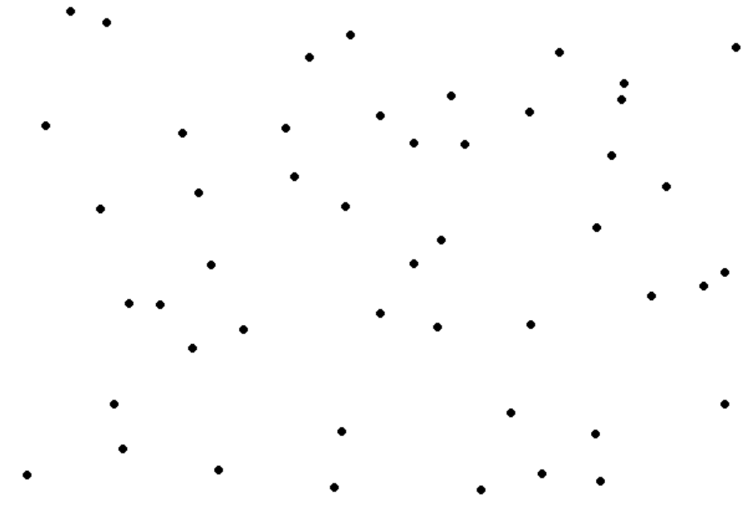
Learn the rules: What kind of puzzle are we dealing with?
Applying these disease treatments yields continuous observed disease burden values, forming a “crowd” of observed values!
High
Each dot is a measurement of a plot
Medium
Nematode pressure
Low
Nil
Nil
Low
Medium
High
Crown rot pressure

Slide 13
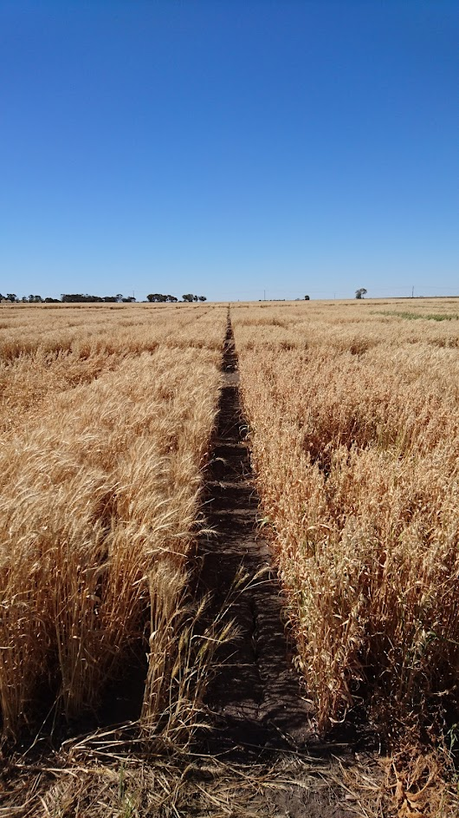




Learn the rules: What kind of puzzle are we dealing with?
On the farm – diseases in the field
Nematodes
Crown Rot
Resistant variety
Susceptible variety
Inoculum
Setup in the year prior to the experiment
Set up at the beginning of the experiment

Slide 14
Solving this experimental design puzzle!
Learn the rules
What kind of puzzle are we dealing with?
Prep our strategy
What statistical techniques can we use to help solve the puzzle?
Real-world puzzling
How does it play out in practice?

Slide 15
Prep our strategy: statistical techniques
Normally our experimental units are assumed to be uniform…
In this case, randomisation acts as an “insurance policy” against variation in our experimental units that we don’t know about
…but what if we did know something that differentiated our experimental units?
Perhaps measured nematode pressures?
What could we do about this?

Slide 16
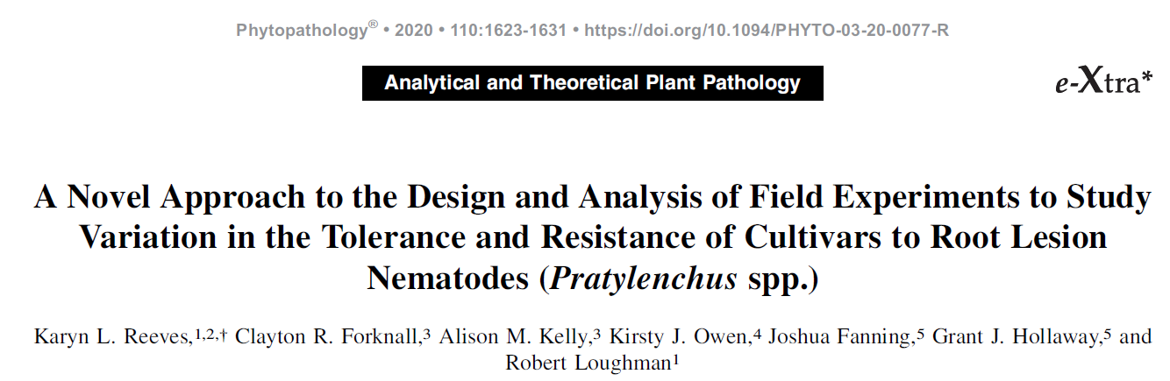
Prep our strategy: statistical techniques
Introducing…
Conditioned randomisation!
Statistical technique for experimental design
Tailor the randomisation of our treatment allocations to a condition that we know is affecting our experimental units
Still respect other sources of variability, and other blocking structures
First published in the context of nematodes by Reeves et al. in 2020

Slide 17
Prep our strategy: statistical techniques
Conditioned randomisation in practice
Arrange the experimental units from lowest to highest nematode pressure
Form blocks, in this case called NemBlocks because that is what we are blocking over
Number of exp. units in each NemBlock is equal to the number of treatments to be allocated
Randomly allocate your treatments within each NemBlock
And also latinise the positions of the treatments within each NemBlock
NemBlock 1
NemBlock 2
NemBlock 3

Slide 18
Prep our strategy: statistical techniques
Nematode Blocks
Treatments
NemBlock 1
Nil
Low
Random allocation
Random allocation
Medium
High
NemBlock 2
Random allocation
NemBlock 3

Slide 19
Prep our strategy: statistical techniques
Randomisation to Rep Blocks is our “insurance policy” against all the things we still don’t know!
Replicate Blocks
Treatments
Random allocation
Rep 1
Nil
Low
Random allocation
Medium
High
Rep 2
Random allocation
Rep 3
But… how can we randomly allocate our treatments to both Rep Blocks and NemBlocks?

Slide 20
Prep our strategy: statistical techniques
Cue: Model-based design!
Model-based designs rely on an underlying variance model for estimating the set of treatment effects, together with an optimality criterion.
We can define all of the sources of variability we anticipate, and use model-based design to balance across them all, where possible
We can prioritise balancing across particular sources of variability, by making their anticipated variance components higher!
The puzzle-solving tool we often use is the odw package in R (optimal design wizard)

Slide 21
Prep our strategy: statistical techniques
Nematode pressure differences (denoted by NemBlock)
Rep block differences
Potential sources of variability
Spatial trends (rows and columns)
Position of allocation within each NemBlock
Model-based design can handle it all!
…but what about when real life puts a spin on things?

Slide 22
Solving this experimental design puzzle!
Learn the rules
What kind of puzzle are we dealing with?
Prep our strategy
What statistical techniques can we use to help solve the puzzle?
Real-world puzzling
How does it play out in practice?

Slide 23

Real world puzzling: how does it play out in practice?
On the farm, things can work against our efforts to do science...
…conditions aren’t always conducive to detecting treatment differences
Questions around whether yield losses due to nematodes were repeatable?
Researchers said “we want to maximise our chances of detecting yield losses. How can we do it?”

Slide 24
Real world puzzling: how does it play out in practice?
Answer: to incorporate extra reps at the extreme disease pressures (Nil/High), for extra precision
3
3
3
3
High
3
3
3
3
Medium
Nematode pressure
3
3
3
3
Low
3
3
3
3
Nil
Nil
Low
Medium
High
Crown rot pressure

Slide 25
Real world puzzling: how does it play out in practice?
Answer: to incorporate extra reps at the extreme disease pressures (Nil/High), for extra precision
6
3
3
6
High
Now incorporating extra reps of Nil/High trts!
3
3
3
3
Medium
Nematode pressure
3
3
3
3
Low
6
3
3
6
Nil
Nil
Low
Medium
High
Crown rot pressure

Slide 26
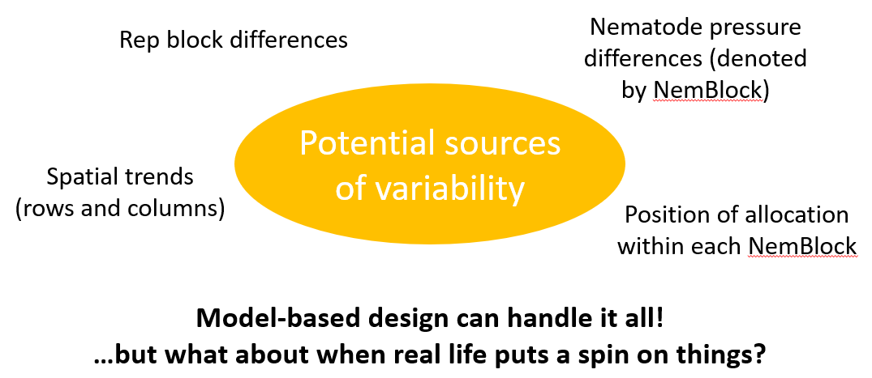
Real world puzzling: how does it play out in practice?
Conditioned randomisation design framework
+
Trying to incorporate extra reps into the design process!

Slide 27
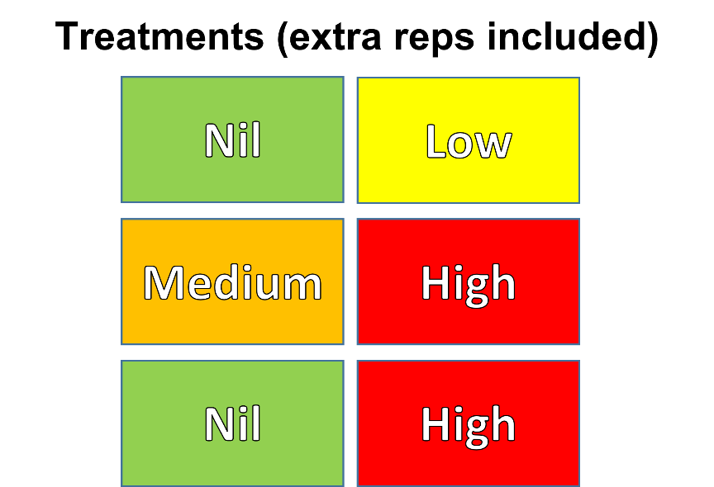
Real world puzzling: how does it play out in practice?
How did we implement this design strategy?
We used the odw package to perform two randomisations:
Randomisation 1
Randomly allocate extra reps of the crown rot (CR) Nil/High treatments
Ensure the extra rep crown rot treatments are allocated to plots with extreme (really small/really large) nematode pressures

Slide 28
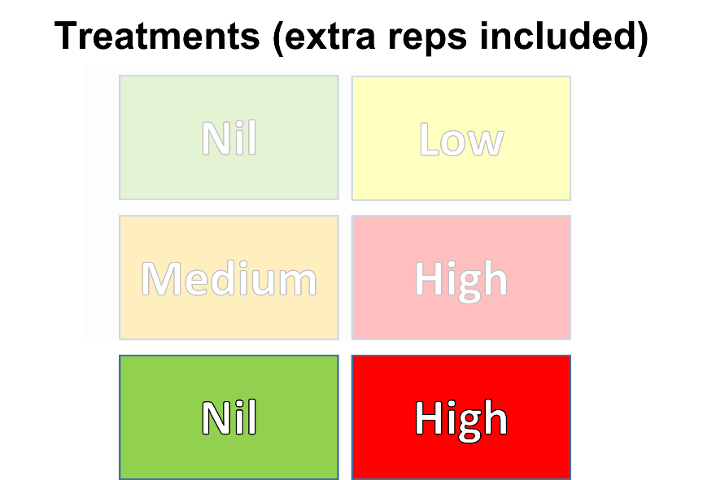
Real world puzzling: how does it play out in practice?
How did we implement this design strategy?
We used the odw package to perform two randomisations:
Randomisation 1
Randomly allocate extra reps of the crown rot (CR) Nil/High treatments
Ensure the extra rep crown rot treatments are allocated to plots with extreme (really small/really large) nematode pressures

Slide 29
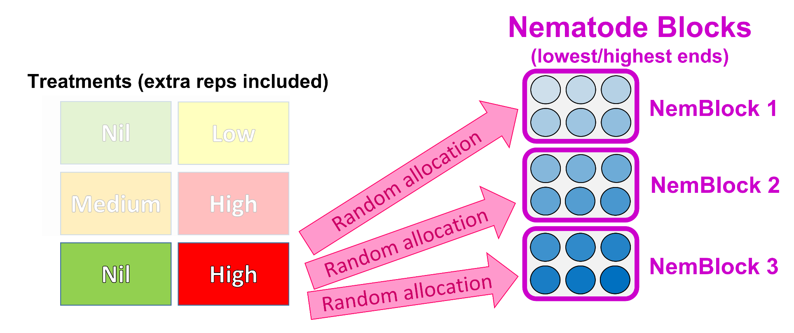
Real world puzzling: how does it play out in practice?
How did we implement this design strategy?
We used the odw package to perform two randomisations:
Randomisation 1
Randomly allocate extra reps of the crown rot (CR) Nil/High treatments
Ensure the extra rep crown rot treatments are allocated to plots with extreme (really small/really large) nematode pressures
Balance across
Rep Blocks
NemBlocks

Slide 30
Real world puzzling: how does it play out in practice?
How did we implement this design strategy?
We used the odw package to perform two randomisations:
Randomisation 1
Randomly allocate extra reps of the crown rot (CR) Nil/High treatments
Ensure the extra rep crown rot treatments are allocated to plots with extreme (really small/really large) nematode pressures
Balance across
Rep Blocks
NemBlocks
Randomisation 2
Freeze positions of extra reps of the crown rot Nil/High treatments
Randomly allocate original reps of all of the crown rot treatments
Balance across
Rep Blocks
NemBlocks
Nematode treatments
Spatial layout
Creative specification of variance components, as well as “swap blocks”, in odw

Slide 31
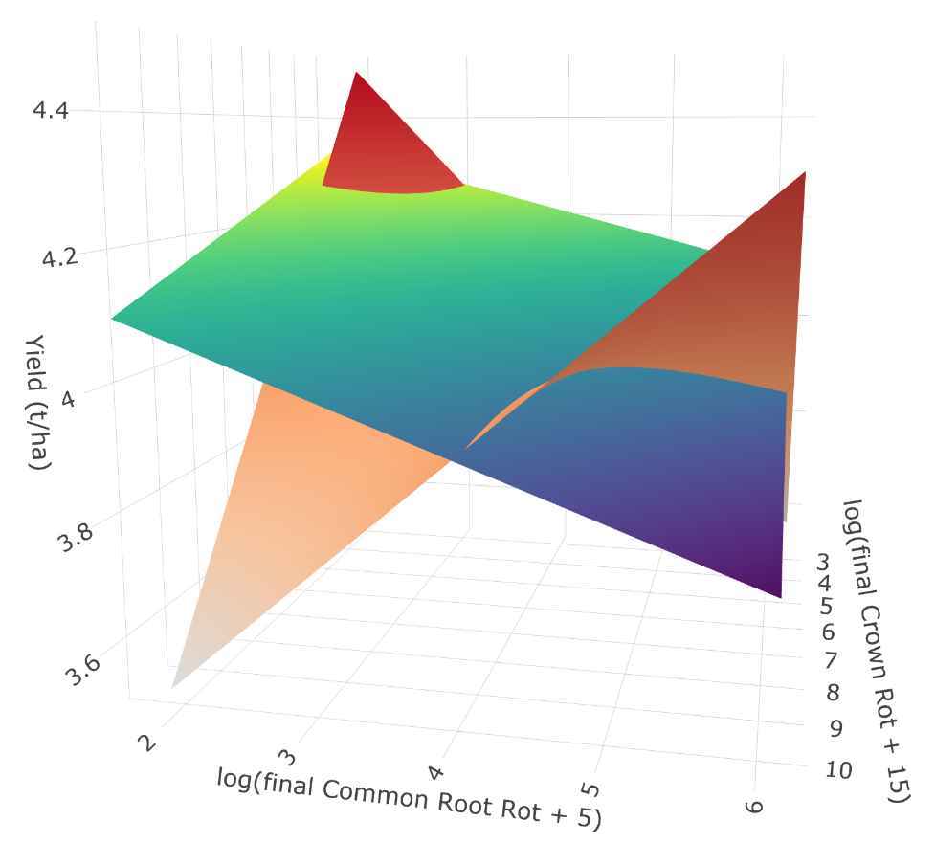
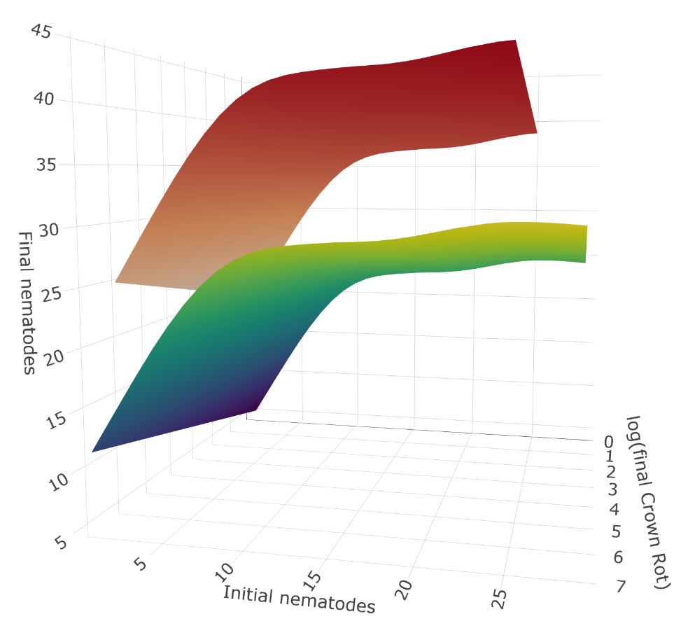
Puzzle solved!
We started with a factorial treatment structure…
Took advantage of the opportunity for a conditioned randomisation design framework…
Incorporated extra reps of our Nil/High disease treatments…
To achieve the “crowd” of diseases we were after…
And through these designs, set the stage for yield response surfaces to show the interaction effect of both diseases!!!

Slide 32
Real-world puzzling!
Learn the rules!
Prep our strategy!
Have fun!

